Slide 1
Big Mountain Resort Data Science

Slide 2
Big Mountain Resort Now
Big Mountain Resort currently charges a premium weekend pass of $81
Big Mountain Resort recently installed a new chairlift with an annual operational cost of $1.54 million
Big Mountain Resort suspects that they may be underutilizing some of its facilities
Big Mountain Resort is hoping to find a way to cut costs or a way to raise prices

Slide 3
Key Findings
Big Mountain currently sits at the top (relative to other resorts)of most of the relevant features, including:
vertical_drop
Snow Making_ac
total_chairs
fastQuads
Runs
LongestRun_mi
trams
SkiableTerrain_ac

Slide 4
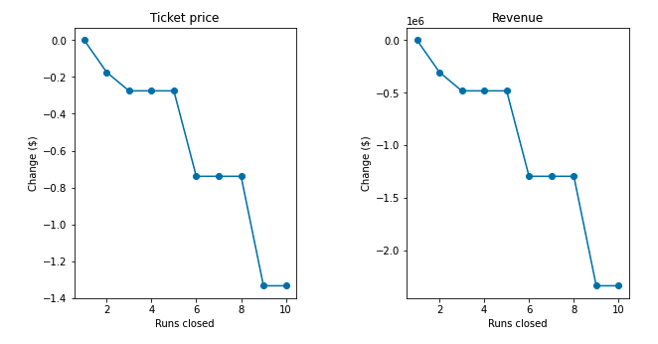
Modeling Results: Scenario 1
Close up to 10 of the least used runs
Closing one run makes no difference
Closing 2 and 3 runs reduces support for ticket price
Closing 4 or 5 runs produces the same loss in revenue as closing 3 runs
Closing 6 or more runs leads to large drop in ticket price and revenue

Slide 5
Modeling Results: Scenario 2
Add a run, increase the vertical drop by 150ft, and install a new chairlift
Increases support for an increase of ticket price by $161
Over the season, this is expected to amount to $2,815,217

Slide 6
Modeling Results: Scenario 3
Add a run, increase the vertical drop by 150ft, install a new chairlift, and add 2 acres of snow making
This scenario gives the exact same results as scenario 2
Increases support for an increase of ticket price by $161
Over the season, this is expected to amount to $2,815,217

Slide 7
Modeling Results: Scenario 4
Increase the longest run by 0.2 miles and guarantee its snow coverage by adding 4 acres of snow making capability.
This scenario resulted in making no difference

Slide 8
Conclusion
Scenario 2 yields the best results
It will allow for an increase in price that will cover the seasonal operational cost of adding the new chairlift

